Slide 1
VueJS Render Functions And Functional Components
Dan Aprahamian

Slide 2
Outline
Who Am I?
Imperative vs. Declarative Rendering
Examples
Questions?

Slide 3

Who Am I?
Dan Aprahamian
NYC-based for the last 9 years
Software Engineer at MongoDB on Node Driver
Five Years of Web Development experience

Slide 4
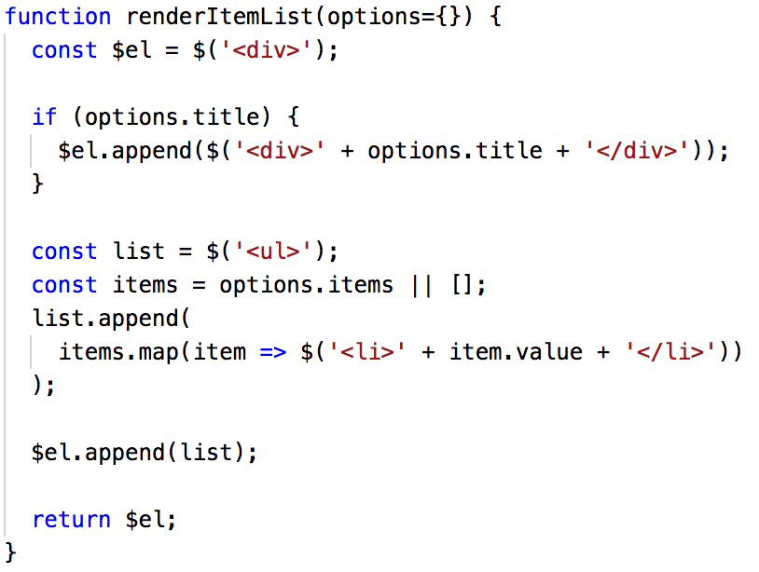
Imperative Rendering
Describe how to render a view
Done via raw JavaScript
Have full power of JS at your disposal
Harder to read
Examples
Jquery
Backbone.js
React without JSX

Slide 5
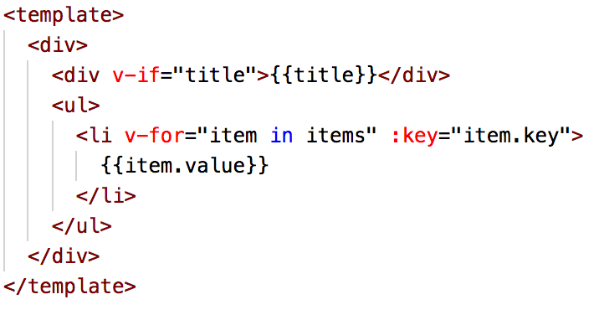
Declarative Rendering
Describe what to render for view
Done via templates / JSX
Limited by templating language
Easier to read
Examples
Marionette.js
AngularJS
React with JSX

Slide 6
Vue has best of both worlds
Provides template syntax to handle most use cases
Declarative template is compiled to Imperative render function
Alternative: write render function directly

Slide 7
When should you write a render function?

Slide 8
Example
A component with multiple options that:
Are mutually exclusive
Impact the DOM hierarchy

Slide 9
Questions?
This presentation and project: https://github.com/daprahamian/vue-render-functions-example/
Vue documentation on Render Functions: https://vuejs.org/v2/guide/render-function.html
Instructions on how to add JSX support: https://www.npmjs.com/package/babel-plugin-transform-vue-jsx
ESLint plugin for Vue to suppress JSX errors: https://www.npmjs.com/package/eslint-plugin-vue

